Slide 1

The Role of Colonization and Positionality in Global
Health Systems
Beatrice Mushi, MD, MPH;
Cesar Mendez Lizarraga, MD, MPH;
Elizabeth M. Rojo, MA;
Frankline Okiiry, MBA;
Holly Nishimura, PhD, MPH;
Margaret Mukoko, PhD;
Michael Reid, MD;
Mwayiwawo Madanitsa, MD, PhD;
Purba Chatterjee, MSc
Notes:
Welcome to this training on The Role of Colonization and Positionality in Global Health Systems.
This training was co-developed amongst all these individuals listed here, representing 5 institutions that include KEMRI in Kenya, MUHAS in Tanzania, MUST in Malawi, UZ-CTRC in Zimbabwe and UCSF.
While we understand that the road to decolonize global health is a long one, we are taking one step with this training and focusing on getting the conversation started amongst our groups.
We have used existing literature on this topic and acknowledge that there are gaps that don’t include all voices or perspectives.
Acknowledge positionality in relation to this training. Share self-reflection and intersectional identities and how that impacts how you show up especially how your identif
***********************************
Add to post-survey:
Based on your lived exp would you change the framing on anything presented in the training?

Slide 2
Learning Objectives
List and define at least three legacies of colonialism that impact today’s global health systems
Identify your position in global health partnerships related to power and privilege
Reflect on one personal bias that could impact global health partnerships you’re involved in
Explain the three pillars of cultural humility
Notes:
With all of our intersectionalities in mind, let’s review the learning objectives.
List and define at least three legacies of colonialism that impact today’s global health systems
Identify your position in global health partnerships related to power and privilege
Reflect on one personal bias that could impact global health partnerships you’re involved in
Explain the three pillars of cultural humility
******************************************

Slide 3
Agenda
Topic | Time
Outline for Session and Ice Breaker | 5 minutes
Topic 1: Background: History and Legacies of Colonialism | 15 minutes
Topic 2: Current Manifestations of Colonialism | 45 minutes
Topic 3: Applied Skills/Resources | 45 minutes
Course Wrap-up | 10 minutes
Notes:
Our agenda for today is as follows:
We’ll spend the next 5 minutes or so talking about our training itself and do have a short ice breaker to get us comfortable in the chat.
Then we’ll spend 15 minutes going over the history and legacies of colonialism
We’ll spend 45 minutes talking about current manifestations of colonialism which includes a small group activity in breakout rooms.
Similarly with our third topic, we’ll spend 45 minutes talking about applied skills and resources with a small group activity.
We’ll wrap up today’s day with some reflections and next steps.
*************************************
Outline for session & ice breaker (5-minutes)
Topic 1: Background, history, and legacies of colonialism (Total: 15 min)
Reflections on asynchronous material (5 min)
Didactic (10 minutes)
Topic 2: Current manifestations of colonialism (Total: 45 min)
Didactic & case study (15 min)
Small group (25 min)
Large group debrief (5 min)
Topic 3: Applied Skills/Resources (Total: 45 min)
Didactic 10 min
Small group 20 min
Large group debrief 15 min
Course reflection/feedback (Total: 10 minutes)

Slide 4
Brave Space and Content Warning
There may be triggers in our conversation today.
It takes being in the right mental space and having an open heart and mind to receive information. The important thing is that we are collaborating to embark on this conversation.
Notes:
Given the nature of our main topic in today’s training, I want to remind everyone that this is a brave space. While we cannot guarantee it to be a safe space –since we don’t know what everyone’s triggers are.
There may be triggers in our conversation today. It takes being in the right mental space and having an open heart and mind to receive information. The important thing is that we are collaborating to embark on this conversation.
We therefore want to make this a brave space where everyone feels welcome to share their thoughts and opinions.
We do have some group agreements on how to do that….next slide.
********************************************

Slide 5
Group training agreements
Participate and be present
Space: make it & take it
Seek to understand
Respect and be mindful of language
Speak in “I” statements
Don’t speak for an entire community or ask others to do so
Recognize impact vs intent
Notes:
Our group training agreements are:
Participate and be present
Space: be sure to make it and allow other to speak up & take it, allow yourself to share your thoughts with the group
Seek to understand
Respect and be mindful of language
Speak in “I” statements
Don’t speak for an entire community or ask others to do so
Recognize impact vs intent, though we may not want to cause harm with our words, sometimes they land the wrong way and it is important to recognize the impact our words have and not focus on our intent.
***************************************

Slide 6

Ice Breaker
If you could be an animal, which one would you pick?
Notes:
Let’s get started in the chat.
Share with the group, If you could be an animal, which one would you pick?
HOST: read answers from the chat and share yours.
*************************************

Slide 7
“If we are going to interfere in the lives of others, a little due diligence is a minimum requirement.”
  -Teju Cole
Notes:
https://depts.washington.edu/globalhealthjustice/the-white-savior-industrial-complex/
To bring us back to our topic, we added this quote by Teju Cole who is a Nigerian-American writer, “If we are going to interfere in the lives of others, a little due diligence is a minimum requirement.”
*************************************

Slide 8
History and Legacies of Colonialism
Background
Notes:
Let’s jump right into our first topic: History and Legacies of Colonialism.
*******************************

Slide 9

Share with the group
What are your initial reflections on the self-study materials?
Notes:
You had a few articles to review before our training and we hope that you all had a chance to look at them. It will definitely help us in our discussion through the training.
Before asking about specific publications, I want to open this short discussion with a general question to the entire group. What are your initial reflections on the self-study materials?
HOST: allow a few seconds for people to enter in chat or unmute themselves to share
Prompt discussion by asking about this quote from a particular article.
We assigned the reading of the article “Will global health survive its decolonisation?” By Seye Abimbola and Madhukar Pai. In there there was this quote “ The imaginative leap that allows a global health practitioner to consider their position or an issue from varying viewpoints requires respect and humility. Empathy is not enough. The desire to make the world a better place, however genuine and heartfelt, is not enough. Respect and humility are vaccines against supremacy.”
https://www.sciencedirect.com/science/article/pii/S014067362032417X?via%3Dihub
What does this speak to you? How do you interpret this quote?
************************************
Self study can be distributed via PDF file or through UCSF wiki spaces if accessible to partners.

Slide 10
Impact of Colonialism on:
Diversity | Social Inequity
Creation of border lines between countries to exploit and export resources | Unfair, avoidable differences between groups arising from bad governance, corruption, or cultural exclusion
Race & Class | Economic Inequality
Race: distinct groups created by humans to differentiate them by their physiological and behavioral characters Class: grouping of people into a set of hierarchical social categories | Unequal distribution of resources and opportunity between different groups
https://www.versobooks.com/en-gb/blogs/news/4810-colonialism-as-a-system-for-underdeveloping-africa
Notes:
This section looks at how at how colonialism divided and disadvantaged Africa through
manipulation of cultural and social diversity,
promotion social inequity,
Separation and grouping of humans by race and class, and
Promotion of economic inequality.
Diversity among societies
This refers to different cultural aspects within a society such as beliefs, lifestyles, traditions and value systems.
If fostered or dealt with correctly, diversity can be a good source of enrichment: socially, economically and politically.
However, colonialism prevented this by creating border lines between countries, which caused divisions that made it easy to exploit and export resources.
It created and perpetuated divisions among ethnic and cultural groups
Social Inequity
This is the Unfair, avoidable differences between groups. It arises from bad governance, corruption, or cultural exclusion.
An example would be unequal access to education, or unequal opportunities for skills growth.
Such inequities resulted in disparities between different genders, races, and other social groups .
Race & Class
Race is a result of classification of humans into distinct groups to differentiate them by their physiological and behavioral characters . Examples include Caucasian, Black, Asian
Class results from the grouping of people into a set of hierarchical social categories
Colonialism created systems of racial inequities from which there exists today, a hierarchy of the races with white people at the top
The education, professional, and socio-economic systems that were build during colonization were built around this hierarchy, and have not changed today
Global spread of euro-centric ideologies regarding class under a system that was already built around a racial hierarchy.
The same ideologies regarding race are still prevalent in many societies around the world.
Economic Inequality
This is the Unequal distribution of resources and opportunity between different groups
For this reason, it is argued that southern countries have not attained the economic well-being of the world's industrial countries
Certain types of institutions were developed through deliberate patterns of European settlement which were a major factor in determining economic backwardness of the colonies

Slide 11
The Role Of Colonialism In Shaping Early Global Health Initiatives
When European powers established colonies around the world, they brought their own systems of power and control that were designed to benefit the colonial powers and their economies.
Health initiatives were used to maintain control over colonies. For example:
  In the 19th century, the British colonial government in India established a public health system that was primarily focused on controlling infectious diseases, such as malaria and cholera, that were designed to protect British officials and soldiers from diseases.
  This system was also used to control the movements of Indian people, as quarantine measures were often used to prevent the spread of infectious diseases.
1. Mamdani M. Citizen and subject: Contemporary Africa and the legacy of late colonialism: Princeton University Press; 2018.
2. Prashad V. The darker nations: a people's history of the Third World: The New Press; 2007.
3. Grove RH. Green imperialism: colonial expansion, tropical island Edens and the origins of environmentalism, 1600-1860: Cambridge University Press; 1996
Notes:
In this session, we will explore how the establishment of European colonies around the world brought with them systems of power and control that influenced global health development.
As we delve into the historical context of global health initiatives, it's essential to understand that when European powers established colonies, they introduced their own systems of power and control. These systems were strategically designed to benefit the colonial powers and their economies, often at the expense of the colonized nations.
One way that colonial powers maintained control over their colonies was through health initiatives. These initiatives were not only focused on improving health but also served as tools for exerting authority and dominance.
A striking illustration of this is the 19th-century British colonial government in India. They established a public health system primarily aimed at controlling infectious diseases, such as malaria and cholera. By doing so, they intended to protect British officials and soldiers from these diseases.
Moreover, the same health system was utilized to control the movements of Indian people. Quarantine measures were frequently implemented to prevent the spread of infectious diseases, which in turn allowed for greater control over the local population.
********************************

Slide 12
The Role Of Colonialism In Shaping Early Global Health Initiatives
Health initiatives were used as a way of exerting cultural and racial superiority over the colonized peoples. For example:
  The French government launched a campaign to combat the opium trade, which it claimed was a threat to public health in Indochina . The campaign was designed to promote French cultural values and to portray the Vietnamese as morally inferior to the French.
  They also used this strategy to establish the French as the guardians of public health in Indochina.
Trocki CA. Opium, Empire and the global political economy: a study of the Asian opium trade, 1750-1950: Psychology Press; 1999.
Notes:
Not only did early colonial powers use health policies to assert systems of power and control but these were also utilized as a means of exerting cultural and racial superiority over colonized peoples during the colonial era.
One of the significant aspects of early global health initiatives was how they were employed to assert cultural and racial superiority by colonial powers. These initiatives were often used as tools to reinforce the belief in the supremacy of the colonizers over the colonized.
An illustrative example of this is the French government's campaign to combat the opium trade in Indochina. They claimed that opium posed a threat to public health in the region. However, behind this campaign were ulterior motives to promote French cultural values and to portray the Vietnamese as morally inferior to the French.
In addition to promoting their cultural superiority, the French also used health initiatives to establish themselves as the guardians of public health in Indochina. By taking charge of health campaigns, they reinforced their colonial authority and control over the local population.
In conclusion, early global health initiatives were not solely driven by altruistic intentions. Instead, they were often employed as tools for colonial powers to exert cultural and racial superiority over the colonized peoples. This historical context sheds light on the complexities of global health inequalities and serves as a reminder of the need to address the legacies of colonialism in modern global health practices.
***************************************************

Slide 13
Historical Context: The Origins of the Global Health Agenda
Tropical Medicine
International Health
(19th Century)
International Sanitary Conferences
(Mid- 19th Century)
World Health Organization
20th Century
(1948)
Infectious Diseases
NCDs
Mental Health
Social Determinants
Millennium Development Goals (MDGs)
(2000)
Sustainable Development Goals (SDGs)
(2015)
The WHO has played critical role in shaping the global health agenda by setting health priorities, providing technical support to countries, and coordinating global health initiatives.
Notes:
Here is an overview of the establishment of the global health agenda
We can see that it has been shaped by a range of factors, including the emergence of new health challenges, advances in medical technology, and political and economic factors.
It was first called tropical medicine, it can then be traced back to the 19th century when the concept of international health emerged as a response to the spread of infectious diseases.
Followed by the creation of the International Sanitary Conferences in the mid-19th century, which focused on the standardization of quarantine measures and sanitary regulations across borders.
It continued to evolve in the 20th century, with the establishment of international health organizations such as the World Health Organization (WHO) in 1948.
As you know, the WHO has a critical role in shaping the global health agenda by setting health priorities, providing technical support to countries, and coordinating global health initiatives.
the global health agenda then expanded to address a wider range of health issues beyond infectious diseases: non-communicable diseases, mental health, and the social determinants of health.
The Millennium Development Goals (MDGs) were adopted by the United Nations in 2000 with 8 goals to combat poverty, hunger, disease, illiteracy, environmental degradation, and discrimination against women by 2015. Although they had made progress worldwide, in 2015 they came together and adopted the Sustainable Development Goals (SDGs) which have played a crucial role in shaping the current global health agenda by setting targets and indicators for health and other development issues.
**********************************************

Slide 14
Neocolonialism and Legacies
Neocolonialism is a form of indirect control that continues to exert economic, political, and cultural influence over formerly colonized countries even after they gain independence.
For example, pharmaceutical companies based in wealthy countries often exert significant influence over healthcare policies in developing countries.
Neocolonialism creates a system of resource exploitation of the Global South by governments and multi-national corporations of the Global North that perpetuates economic and political dependency.
The Role of Colonization and Positionality in Global Health Systems
Notes:
Let’s talk about Neocolonialism.
The concept emerged in the mid-20th century as countries gained independence from their colonizers but continued to be controlled and exploited by developed nations.
Neocolonialism It is a form of indirect control that continues to exert economic, political, and cultural influence over formerly colonized countries even after they gain independence.
For example, pharmaceutical companies based in wealthy countries often exert significant influence over healthcare policies in developing countries.
Neocolonialism creates a system of resource exploitation of the Global South by governments and multi-national corporations of the Global North that perpetuates economic and political dependency.
**********************************

Slide 15
Legacies of Colonialism
White supremacy has a long history in global health, beginning with the colonial era, during which European powers imposed their own systems of healthcare on colonized peoples. This often involved forced medical experimentation and the suppression of traditional medical practices.
The legacy of colonialism continues to impact global health today, as many countries that were once colonies still struggle with inadequate healthcare systems and a lack of trained healthcare professionals.
White supremacy has also been reflected in the way that global health research has traditionally been conducted, with a focus on studying and developing treatments for diseases that primarily affect people in wealthy countries, while neglecting the health needs of people in developing countries.
The Role of Colonization and Positionality in Global Health Systems
Notes:
White supremacy has a long history in global health, beginning with the colonial era, during which European powers imposed their own systems of healthcare on colonized peoples. This often involved forced medical experimentation and the suppression of traditional medical practices.
The legacy of colonialism continues to impact global health today, as many countries that were once colonies still struggle with inadequate healthcare systems and a lack of trained healthcare professionals.
White supremacy has also been reflected in the way that global health research has traditionally been conducted, with a focus on studying and developing treatments for diseases that primarily affect people in wealthy countries, while neglecting the health needs of people in developing countries.
*******************************************

Slide 16
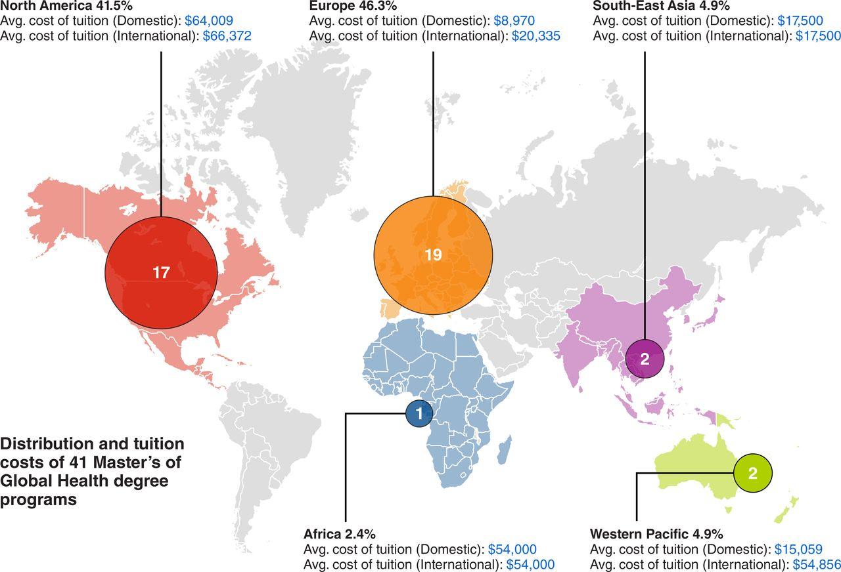
Global Health Education: Cost & Distribution of GH degrees
Source:
Anita Svadzian, et al. Global health degrees: at what cost? BMJ Global Health 2020;5:e003310.
The Role of Colonization and Positionality in Global Health Systems
Notes:
One area where white supremacy shows up is in global health education.
Despite being a domain of education that is by its very nature 'global,' global health education is far more likely to be taught in high income countries. Moreover, the cost of global health tuition at academic institutions that teach this subject is so high, that many people in low and middle income countries (and even prospective students from low income communities in high income countries) cannot afford to enroll in GH programs.
This slide illustrates the profound disparities in access and affordability to global health education that undermines authentic equity in this academic field.
***************************************

Slide 17
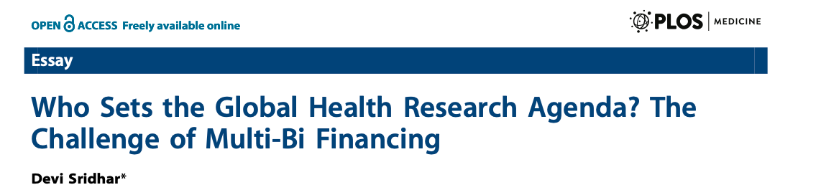
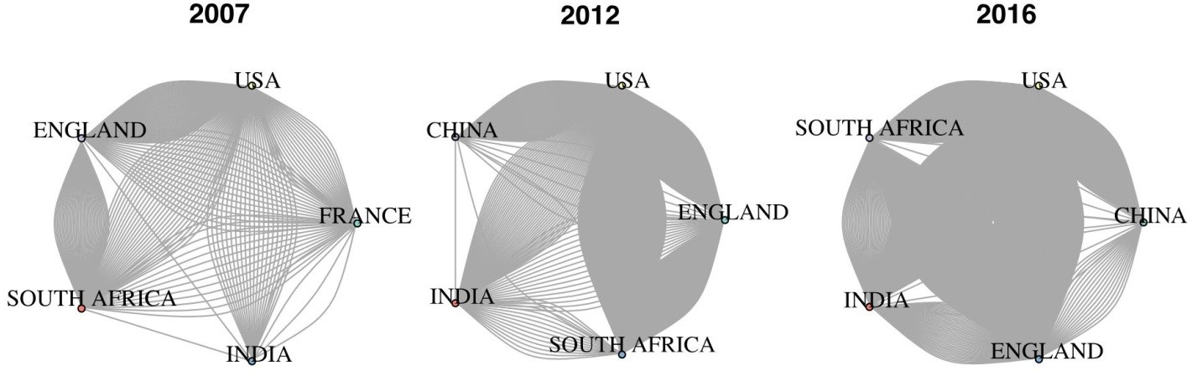
Global Health Research
Policy makers in low- and middle-income countries (LMICs) do not set research agendas or shape what research is funded and where.
Much of global health research is informed by the Golden Rule of Research
He has the gold, rules!
TB research collaborations
Encouraging trends, but still dominated by high income countries (HICs)
Invariably, research agenda are informed by HIC funding institutions (NIH, Welcome, BMGF)….
The Role of Colonization and Positionality in Global Health Systems
SrIDhar, PLOS Med, 2013; Nafade, Plos Med, 2018
Notes:
Beyond Global Health education, white supremacy and neo-colonialism is evident in how and who sets the agenda in many areas of global health research. There is increasing recognition that too often key stakeholders in LMICs are not sufficiently engaged in what research gets funded.
The research article on the left of the screen highlights that the global health research agenda is often determined by funding institutions in high income countries, rather than by researchers in the countries where that research is done.
Beyond who funds GH research, there are also marked discrepancies in who is doing the research. The image on the right of the screen are taken from an analysis of TB research networks and how those have changed over time . While the analysis highlighted here illustrates that TB research networks are becoming more diverse and including partners from LMICs, it is still the case that most TB research is being done by collaborators in a few high income countries, while TB is a disease that disproportionately impacts LICs!
*************************************************

Slide 18
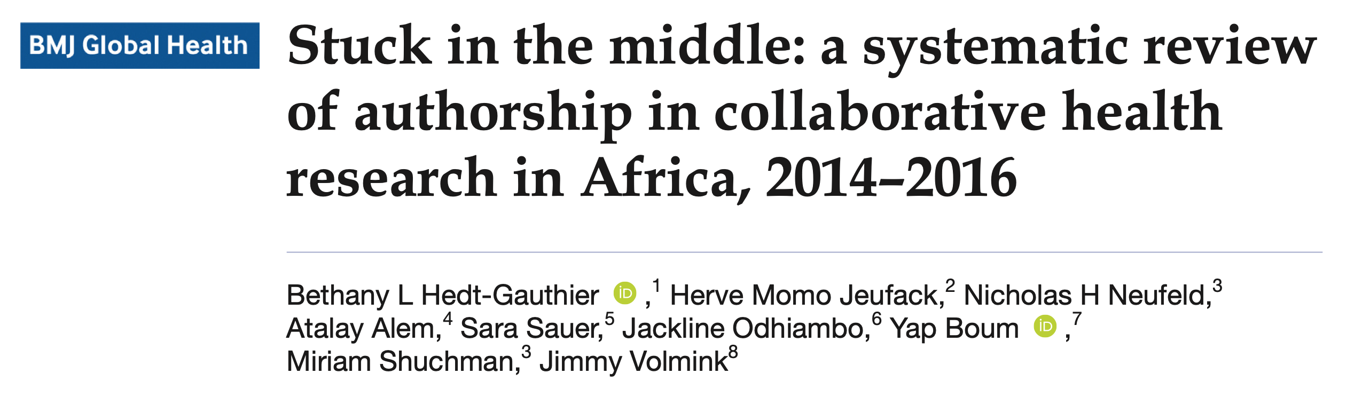
Global Health Authorship:
The Middle Author Problem
Of the 7100 articles identified in this study, 68.3% included collaborators from the USA, Canada, Europe and/or another African country.
The Role of Colonization and Positionality in Global Health Systems
Notes:
When global health research is predominantly from HICs and the research is led by researchers in HICs, it is perhaps unsurprising that the researchers getting published are primarily from HICs.
Global health researchers from Africa, for example, are often under-represented in first and senior authorship positions on academic papers, even when the research is done in their countries.
The paper showcased here highlights how oftentimes, African researchers are 'stuck in the middle' in authorship positions on academic papers [more detail on the next slide].
****************************************************

Slide 19
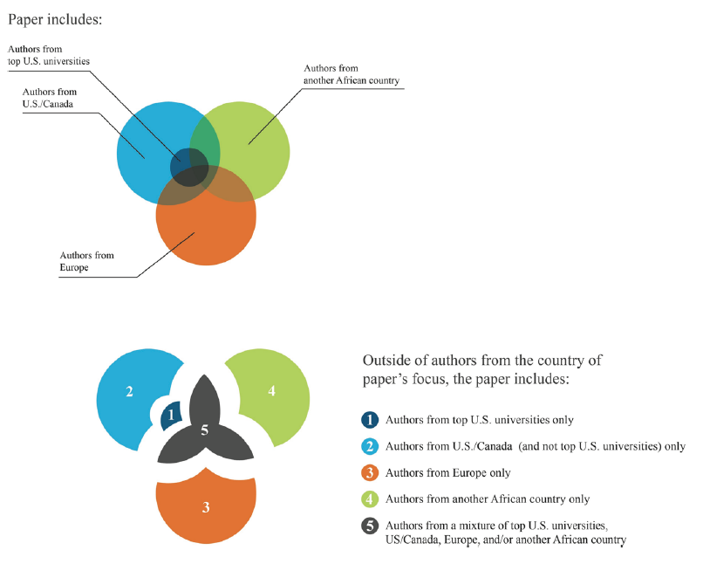
Global Health Authorship:
The Middle Author Problem
54.0% of all authors and 52.9% of first authors were from the country of the paper’s focus.
But representation dropped if any collaborators were from USA, Canada or Europe with the lowest representation for collaborators from top US universities—for these papers, 41.3% of all authors and 23.0% of first authors were from country of paper’s focus.
13.5% of all papers had no local coauthors.
The Role of Colonization and Positionality in Global Health Systems
Notes:
[Same study reviewed as in slide 18]:
In fact, the authors of this paper highlight that only 54.0% of all authors and 52.9% of first authors were from the country of the paper’s focus.
More sobering, the proportion of local authors dropped if any of the others authors were from USA, Canada or Europe. And if the papers included authors from top US universities, then only 41.3% of all authors and 23.0% of first authors were from country of paper’s focus!
Sadly, of the 7100 papers reviewed nearly a thousand (13.5%) of all papers had no local coauthors.
****************************************************

Slide 20
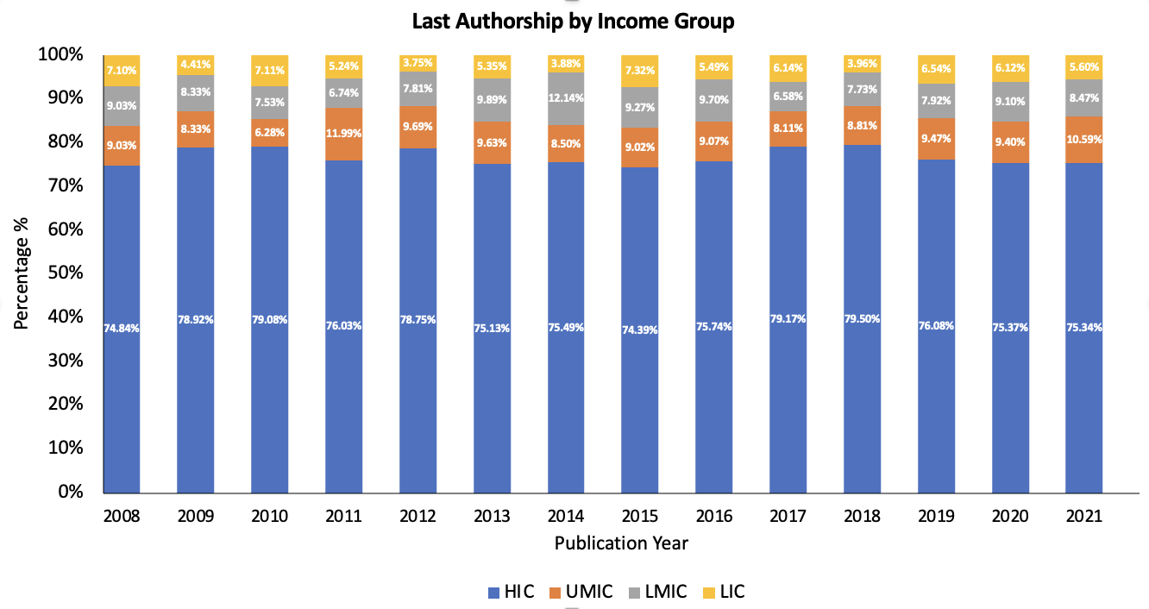
UCSF’s Publication Track Record
Country of origin of last author, UCSF global health publications
Kaufman, In press
The Role of Colonization and Positionality in Global Health Systems
Notes:
UCSF's own track record for advancing representation from global researchers on scholarly work is no better!
In a recent analysis performed UCSF's institute for Global health sciences, researchers looked at global health research produced by UCSF between 2008 and 2021.
They evaluated over 5000 global health publications published by UCSF staff and faculty during this time period and found that LMIC researchers were listed as last author only 23.4% (n=1,354) of the time (as the plot here illustrates). Unfortunately, this representation didn’t change over time; between 2008 and 2021 the vast majority of publications included UCSF authors as first and senior author.
*********************************************

Slide 21
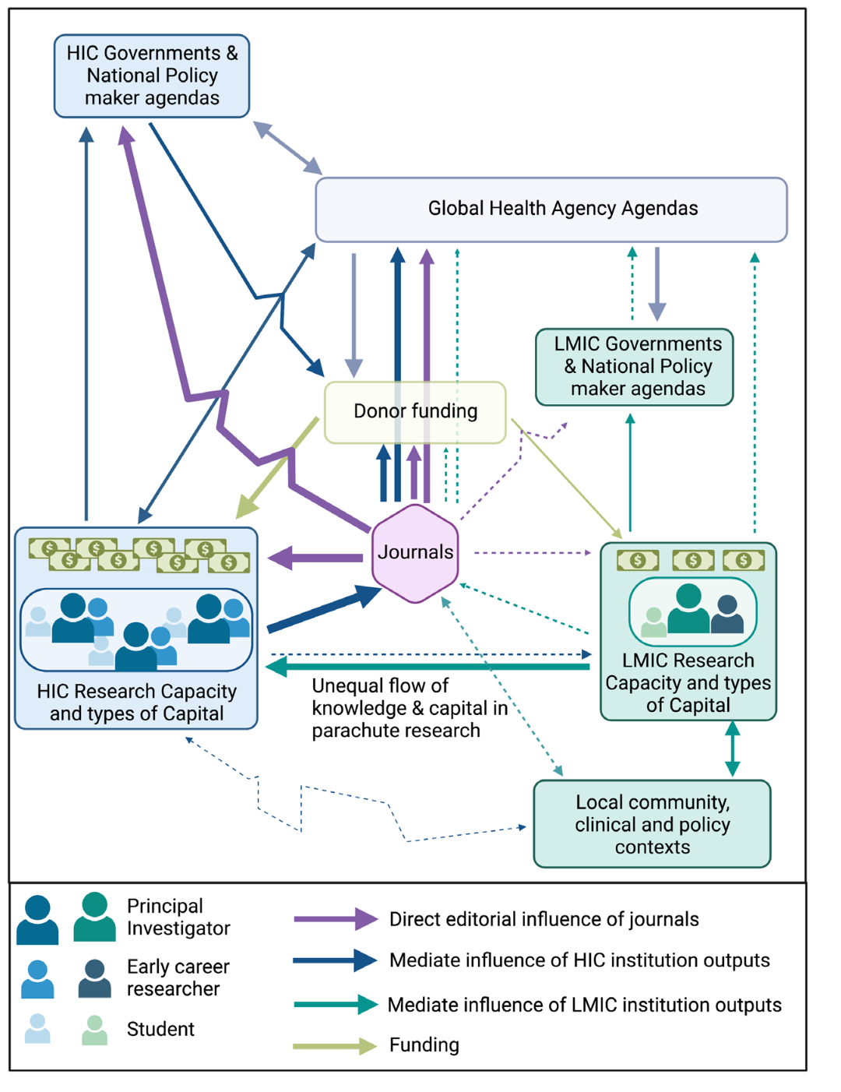
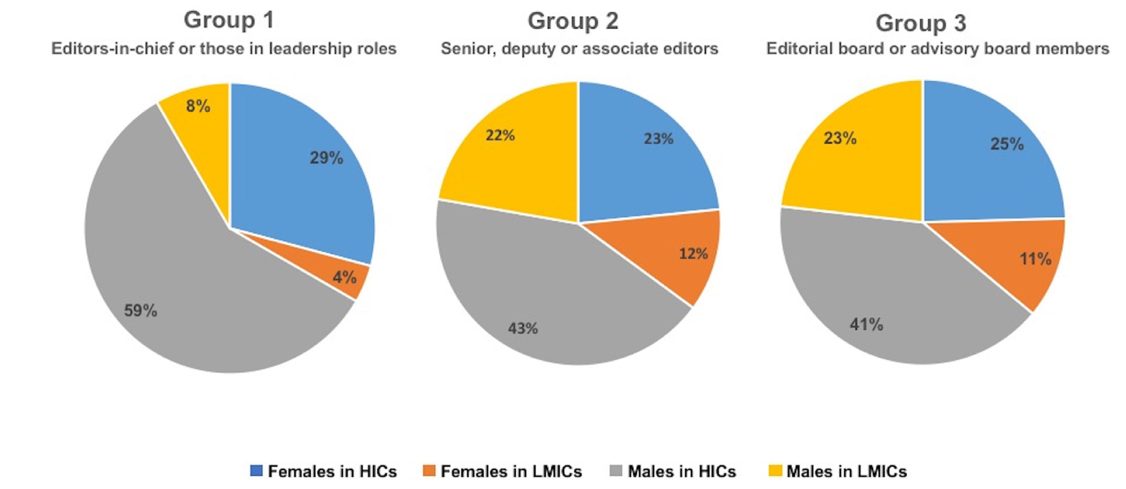
Inequities in Global Health Research
High Income Countries monopolize opportunities for knowledge sharing and dissemination platforms.
Imbalances in journal representation exacerbate and perpetuate global health inequities.
Editors of Global Health journals far less likely to be women or from LMICS²
Lancet, 2019, Nafade BMJ GH, 2019
The Role of Colonization and Positionality in Global Health Systems
Notes:
Its important to understand some of the reasons why these inequities in global health research and education exist.
One important reason is that the gatekeepers of global health research generation - the journals that publish this research – are run by editors that are from the global north. As the pie charts on the left highlight, the vast majority of journal editors-in-chief, senior editors, and editorial boards are from HICs. In addition, the majority are men from HICs.
The plot on the left is from a different article published in the Lancet journal that highlights why greater representation from GH researchers from LMICs on journal editorial boards is so critical, since it informs who gets published, which in turn shapes, global and national health policies, which in turn informs donor financing and strategic planning.
****************************************

Slide 22
Inequities in Global Health Research
The Role of Colonization and Positionality in Global Health Systems
Source: https://globalhealth5050.org/2020report/
Notes:
Lack of global health representation on journal boards is only part of the problem! Global health leadership (on the critical institutions of global health governance like the WHO, Global Fund, GAVI, etc) is disproportionately represented by individuals from HICs.
More specifically, 83% of global health leaders are from high income countries [the vast majority from the US and UK]. And yet, while 85% of the global population is in LMICs only 17% of global health leaders –and only 5% of women GH leaders – are from those countries.
To summarize [and before transitioning to the next section on how colonialism shows in practice], it is critical to address these imbalances in GH leadership, research and education if we are to realize our shared goal for global health equity.
******************************************************

Slide 23
Current Manifestations of Colonialism
Background

Slide 24
Current Manifestations of Colonialism
The White Savior Industrial Complex (WSIC) refers to any person or group, regardless of race, possessing an imbalance of power or privilege.
Non-white people can perpetuate WSIC by their proximity to whiteness, power, or privilege because it relies on these structures to maintain inequality.
It arises from our own questioning “What can I do to help?” After seeing people (especially of color) in need during or after:
  Natural disaster
  environmental disaster
  A pandemic
  Humanitarian crisis
  Seeing inequities Black, Indigenous, and/or People of Color face (BIPOC)
https://blogs.bmj.com/bmjgh/2020/03/11/the-white-savior-industrial-complex-in-global-health/
https://www.health.com/mind-body/health-diversity-inclusion/white-savior-complex
The Role of Colonization and Positionality in Global Health Systems
Notes:
Current manifestations of colonialism are the white savior industrial complex, you may have already heard of this. If not, the white savior industrial complex refers to any person or group, regardless of race, possessing an imbalance of power or privilege.
Some key things to remember about the white savior complex is that
Non-white people can perpetuate WSIC by their proximity to whiteness, power, or privilege because it relies on these structures to maintain inequality.
It arises from our own questioning “What can I do to help?” After seeing people (especially of color) in need during or after:
Natural disaster
environmental disaster
A pandemic
Humanitarian crisis
This is not to say that as a white person, you should try to help in times of needs. WSIC is something to be aware of and can come as part of self-reflection on your intentions.
*****************************
https://blogs.bmj.com/bmjgh/2020/03/11/the-white-savior-industrial-complex-in-global-health/
https://www.health.com/mind-body/health-diversity-inclusion/white-savior-complex

Slide 25
Challenges with Academic Global Health
Study priorities and design dictated by institutions in high-income countries
Imbalance of financial resources between institutions in high-income and low- and middle-income countries, with a paucity of funding opportunities for the latter
Exploitation of investigators in low- and middle-income countries by using their work for the benefit of high-income country investigators without tangible benefit for team members in the country or region where the research is being conducted
Dominance of the English language in the scientific literature and immodest assumptions that the English language literature represents “the sum of all available knowledge”
More favorable authorship roles in publications for those in high-income countries, particularly in international peer-reviewed journals
The Role of Colonization and Positionality in Global Health Systems
Notes:
Lancet Global Health published 16 reports in one issue aimed at answering the question posed by the journal’s editors, “What is wrong in global health?” The problems include, but aren’t limited to:
Study priorities and design dictated by institutions in high-income countries
Imbalance of financial resources between institutions in high-income and low- and middle-income countries, with a paucity of funding opportunities for the latter
Exploitation of investigators in low- and middle-income countries by using their work for the benefit of high-income country investigators without tangible benefit for team members in the country or region where the research is being conducted.
Dominance of the English language in the scientific literature and immodest assumptions that the English language literature represents “the sum of all available knowledge”
More favorable authorship roles in publications for those in high-income countries, particularly in international peer-reviewed journals
************************************
https://www.statnews.com/2023/01/27/checklist-help-decolonize-global-health-research/

Slide 26

Condescending approach to local researchers
Case Study
This is more frequently true of researchers from former colonizing countries such as UK. A natural assumption and behaviours is that the researcher from [a colonized country] have not had international education and they must be explained everything in detail (sort of like mansplaining!). The role distribution also underscores this bias.
For example, instruments are shared with a nice note ‘your input is valuable to adapt this to local contexts, but we have done all of this based on our experience in Africa and Bangladesh already’. It just underscores that all LMICs are being treated equal (which they should not be) and local researchers are not capable of designing a valid tool.
This especially sours partnership if such approach comes from young international researchers who are often themselves developing their research skills as doctoral degree students.
When such power differential is created, we local researchers feel pressurized to not put our best foot forward and work towards a contract and not towards a ‘research partnership’.
The Role of Colonization and Positionality in Global Health Systems
Notes:
Have you experience or witnessed this type of encounter? How did you handle it? How would you have handled it differently?

Slide 27

Condescending approach to local researchers
Let’s Discuss
This is more frequently true of researchers from former colonizing countries such as UK. A natural assumption and behaviours is that the researcher from [a colonized country] have not had international education and they must be explained everything in detail (sort of like mansplaining!). The role distribution also underscores this bias.
  Overexplaining/oversimplifying
For example, instruments are shared with a nice note ‘your input is valuable to adapt this to .. contexts, but we have done all of this based on our experience in Africa and Bangladesh already’. It just underscores that all LMICs are being treated equal (which they should not be) and local researchers are not capable of designing a valid tool.
  Generalizing LMICs with other experience
  Valuing local talent
This especially sours partnership if such approach comes from young international researchers who are often themselves developing their research skills as doctoral degree students.
  Varying levels of experiences
The Role of Colonization and Positionality in Global Health Systems

Slide 28


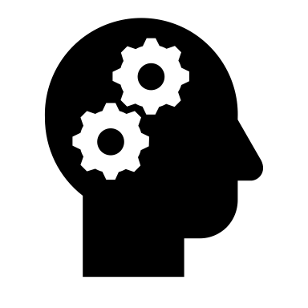
Positionality Awareness
Power
Privilege
Bias
The Role of Colonization and Positionality in Global Health Systems
Notes:
Let’s bring some awareness to our positionality according to three things: our power, our privilege and our biases
************************************

Slide 29
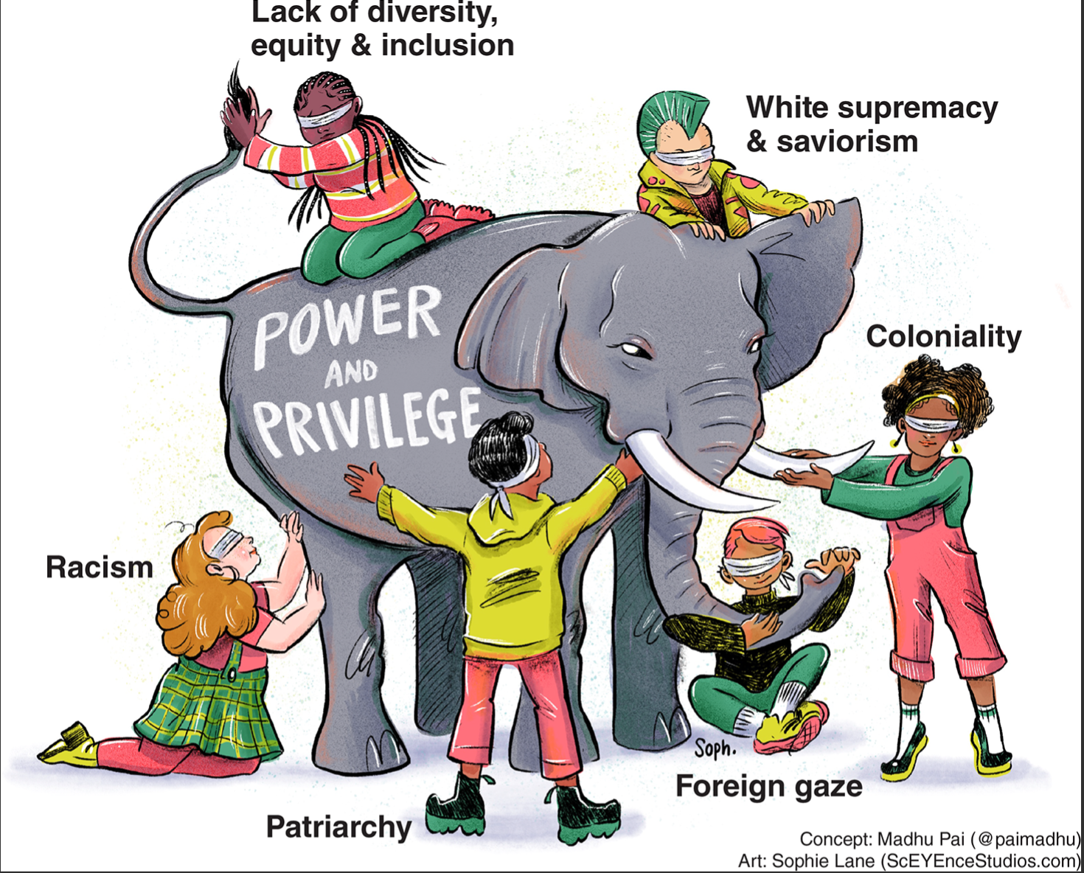
Power dynamics
Power, or lack thereof, has a notable impact on health
Power structures are socially and historically perpetuated
-
The Role of Colonization and Positionality in Global Health Systems
Notes:
Let’s bring our attention to the power dynamics in our work.
We want to make sure we recognize and challenge power imbalance, we can begin by looking at ourselves and analyzing the power and privilege that we bring to the interaction.
Power is a thing that changes depending on the circumstances, so let’s think for a second and center this experience on the work that we are trying to do. We are conducting work abroad and partnering with local colleagues to work on a project together. Historically, there has been an obvious power imbalance in taking associated with white supremacy in taking “white knowledge” as correct information and the only way to do things right. As things are slowly changing in reframing this thought and valuing local expertise, you hold power by the sole fact that you are coming from a HIC and perhaps are white. Event POC that do global health are sometimes seen with white privilege in this setting. In the same way that when two colleagues come from a HIC and one is white and the other is a person of color, there is a power imbalance in that situation with your colleague as well.
Another example of power depending on your settings is the power you may hold at home depending on your role/title, or identities and the shift in power when you go abroad. This power shift might be from low power to high power, or you may feel you lack power.
You should also be aware of institutional power that you might not know you are holding---> for example representing the power of UCSF in your work abroad even if you dont feel empowered at UCSF.
The goal here is that you should be aware of your positionality, power and privilege and you want to be able to challenge those power imbalances by elevating the power of your local counterparts and working together in a project that is serving THEIR community.
We all know that power, or lack thereof, has a notable impact on health and we also know that power structures are socially and historically perpetuated. So being aware of that too.
***************************************

Slide 30
Wheel of
Power & Privilege
Group Activity
Notes:
Let’s do a short group activity around the wheel of power and privilege.
It's important for us to critically reflect on where we hold power and privilege.
It’s important to note that this wheel is not inclusive of all ways we can hold power.
As you can see the center of the wheel list the most power and privilege according to the creators of this wheel and as we move towards the outside of the circle we see the more marginalized groups.
ASK THE GROUP: Would you add other categories to the wheel?
Prompt group: Some examples can include caste or tribe, location (urban vs rural), etc.
Some identities in this wheel are the consequence of and vehicle for vulnerability. We may be mostly in the interior circle, in the exterior circle, or a mix. Wherever we are, that's ok. The point is for us to have an understanding of whether or not the identities that we hold are the "consequence of and vehicle for vulnerability" or if we're protected by our own privileges.
next slide…
********************************
Wheel of Power and Privilege Description (Please do not delete from this slide. These notes are for people who are unable to read the image above.)
Image of wheel of power and privilege. Broken out into a pie chart of 16 different categories. Each category has subsections showing the most power and privilege to the least.
Religion from most power and privilege to least: Christian, non-religious & Christian passing to other religions.
Schooling from most power and privilege to least: Post secondary, high school education, elementary education.
Ability from most power and privilege to least: Enabled, some disability, significant disability.
Neurodiversity from most power and privilege to least: Neurotypical, some neuro-divergence, significant neuro divergent
Criminal record from most power and privilege to least: Never incarcerated, formerly incarcerated, incarcerated
Race from most power and privilege to least: White, non-black POC, Black
Mental health from most power and privilege to least: Robust, mostly stable, distressed.
Coloniality from most power and privilege to least: White settler-colonizers, Black & POC settlers, Indigenous people.
Housing from most amount of power and privilege to least: Owns property, sheltered renting, unhoused.
Wealth from most amount of power to least: Rich, middle class, poor.
Employment from most amount of power to least: White color/salaried, Blue color/hourly, Informal/unemployed
Language from most amount of power and privilege to least: Native English, learned English, non-English/monolingual
Gender from most amount of power and privilege to least: Cisman, ciswoman, Trans, intersex, non-binary
Citizenship from most amount of power to least: Citizen, documented, undocumented
Sexuality from most about of power and privilege to least: Heterosexual, gay man, lesbian, bi, pan, asexual
The Wheel of Power and Privilege is built on the work of Kimberlé Crenshaw, Crossroads Anti-Racism, Canadian Council for Refugees, and Sylvia Duckworth.
Due to limited space, this graphic does not fully express the full complexity of intersectional identity.

Slide 31
Positionality Group Activity
Locate ourselves in the wheel of privilege and power
Race
Gender
Language
The Role of Colonization and Positionality in Global Health Systems
Notes:
Let’s locate ourselves in the wheel of power and privilege and answer in chat where are you located in terms of race, gender and language.
HOST: enter yours and read some answers from chat.
For me, I am non-black person of color, cis-woman who learned English.
*************************************

Slide 32
Is Power An Opportunity Or
A Responsibility?
The Role of Colonization and Positionality in Global Health Systems
Notes:
Now that we have reflected a bit on our positionality in terms of power and privilege, here is a question you can think about and reflect on:
Is power an opportunity or a responsibility?
*******************************************

Slide 33

Bias in Global Health
Group Discussion
How were you socialized around health?
How were you socialized around people / communities / systems from higher or lower income countries than yours?
The Role of Colonization and Positionality in Global Health Systems
Notes:
Let’s talk about our own personal bias, which could have been shaped by our positionality.
Let’s answer in chat or come off mute.
How were you socialized around health?
How were you socialized around people / communities / systems from higher or lower income countries than yours?
************************************************

Slide 34
Bias in Global Health
Bias is prejudice in favor of or against one thing, person, or group compared with another, usually in a way considered to be unfair.
Conscious or
Explicit Bias
Unconscious or
Implicit Bias
The Role of Colonization and Positionality in Global Health Systems
Notes:
These early life experiences have shaped our believes and formed our biases.
The definition of bias is: Bias is prejudice in favor of or against one thing, person, or group compared with another, usually in a way considered to be unfair.
There are many types of bias, some examples are:
Racial
Sexual & Gender Minority
Cognitive or Physical Ability
Age
Etc.
There are two types of biases:
Conscious/Explicit Bias
Unconscious/Implicit Bias
We’ll talk more about Implicit bias
*********************************************

Slide 35

Implicit bias is “a positive or negative mental attitude towards a person, thing, or group that a person holds at an unconscious level”.
  40-90% of all behavior is unconscious
Affinity Bias: a feeling a connection to those similar to us
Perception Bias: stereotypes and assumptions about different groups
Confirmation Bias: looking to confirm our own opinions and pre-existing ideas
Halo Effect: projecting positive qualities onto people without actually knowing them
The Role of Colonization and Positionality in Global Health Systems
Notes:
Implicit bias is “a positive or negative mental attitude towards a person, thing, or group that a person holds at an unconscious level”.
Affinity Bias- feeling a connection to those similar to us
Perception Bias- stereotypes and assumptions about different groups
Confirmation Bias- looking to confirm our own opinions and pre-existing ideas
Halo Effect- projecting positive qualities onto people without actually knowing them
Like we said before, there are other types of bias too:
Appearance bias. ...
Attribution bias. ...
Gender bias. ...
Age bias. ...
Authority bias. ...
Biases help us address 4 problems:
Too much information
Not enough meaning
Need to act fast
What we should remember and discard—but there are pitfalls
Some biases are positive and helpful—like choosing to only eat foods that are considered healthy or staying away from someone who has knowingly caused harm.
However, we don’t want to fall into our biases in discriminating others.
*****************************************************

Slide 36
How Does Bias Originate?
Can be learned through
Historical Context
Science
  Systematic Racism
  Institutionalized Discrimination
  Historical Oppression
  40-90% of all behavior is unconscious
  Our brains 11 million bits received @ any moment. We can only process 40 bits
  Our brains create unconscious mental shortcuts-implicit processes
  Past experiences
  Social messages
  Passed from generation to generation
The Role of Colonization and Positionality in Global Health Systems
Notes:
How does bias originate?
It can be learned through:
Past experiences
Social messages
Passed from generation to generation
Historical Context
Systematic Racism
Institutionalized Discrimination
Historical Oppression
Science
40-90% of all behavior is unconscious
Our brains 11 million bits received @ any moment. We can only process 40 bits
Our brains create unconscious mental shortcuts-implicit processes
*******************************************

Slide 37
Ways Bias Can Impact Partnerships
May influence information and resources that are offered
Verbal/nonverbal communication
Building rapport
Resistance to recommendations and bidirectional learning
The Role of Colonization and Positionality in Global Health Systems
Notes:
Some ways bias can impact partnerships
May influence information and resources that are offered
Building rapport
Verbal/nonverbal communication: Doing a pulse check around your verbal and nonverbal communication, cultures have different ways of communicating. if you’re an excited new yorker it can come across as too aggressive or soft spoken it can come out as dismissive
Resistance to recommendations
***********************************

Slide 38
Small Group Activity #1
Breakout Session
(30 minutes)
Intersectional Identities and Power Imbalances
Objectives:
Reflect on how our intersectional identities, our personal values and our implicit biases may contribute to the power imbalances you may experience in your global projects.
How can you mitigate the power imbalances around your global work?
Report back: Select someone from your group to report back
The Role of Colonization and Positionality in Global Health Systems
Notes:
We will now break into our first activity in small groups.
It will be on Intersectional Identities and Power Imbalances, our objectives for this activity are to:
Reflect on how our intersectional identities, our personal values and our implicit biases may contribute to the power imbalances you may experience in your global projects.
How can you mitigate the power imbalances around your global work?
You will have 30 minutes for this activity and decide amongst your group who will report back to the larger group.
Your facilitator will provide you more details.
**********************************************

Slide 39
Welcome to the main room
Please use the chat or microphone to tell us how we can help you.
If you need to return to your breakout room, please tell us the room number or facilitator name.

Slide 40
Breakout Activity Debrief
Please share with the larger group the key points from your small group discussion.
  Reflect on how our intersectional identities, our personal values and our implicit biases may contribute to the power imbalances you may experience in your global projects.
  How can you mitigate the power imbalances around your global work?
The Role of Colonization and Positionality in Global Health Systems
Notes:
Welcome back! I hope you had an insightful discussion. Who wants to go first and report back on something that was shared in your groups that stayed with you?
HOST: if no learner volunteers, ask facilitators to share back.
****************************************

Slide 41
Applied Skills and Resources

Slide 42
Creating Equal Partnerships
While there is a lot to be done, a good place to start is in creating equal partnerships with our global health partners.
Identify resources:
  LMIC: local expertise, language and culture, access to the communities, research and knowledge production
  HIC: funding, western scientific processes, research and knowledge production experience from Global North
The Role of Colonization and Positionality in Global Health Systems
Notes:
Setting up an equal partnership among collaborators is key to satisfied and sustainable partnerships.
This starts with identifying what each partner can bring to the table and what each expects to get out of the partnership
Funding is very important but not everything… success is dependent on other crucial elements like, local expertise, access to communities, autonomy on patients, language/culture and knowledge on relevant context and so on

Slide 43
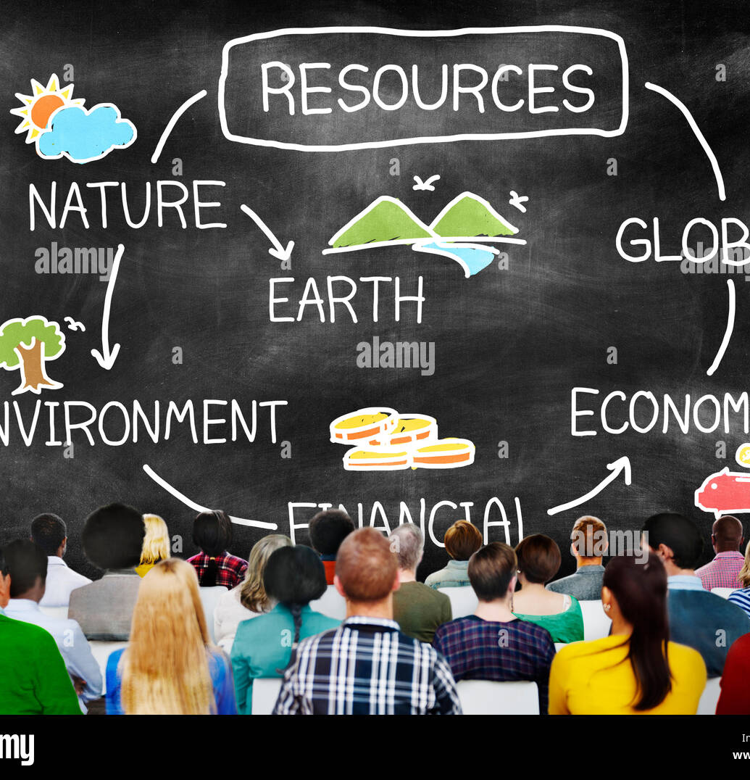
Economic Resources
Studies conducted are heavily influenced by funding agencies, mainly based in the West. Research agenda may not reflect the interests of local needs or context
Western investigators often have a natural advantage in receiving funds from Western organizations due to eligibility criteria
Even if eligible, African investigators have limited access to the ‘trade secrets’ requirements of successful grant applications
Until research is locally relevant and valued, local funding will remain elusive
The Role of Colonization and Positionality in Global Health Systems
Notes:
While funders typically identify research priorities based on strong scientific premise and clinical need, the types of studies conducted are heavily influenced by funding agencies, which are mainly based in the West. Though their research agendas often address important areas, they may not reflect the interests of African partners, which tend to be more grounded in local needs.
Western investigators often have a natural advantage in receiving funds from Western organizations due to eligibility criteria
Even if eligible, African investigators have limited access to the ‘trade secrets’ requirements of successful grant applications
Until research is locally relevant and valued, local funding will remain elusive
*****************************************
Boum II Y, Burns BF, Siedner M, et al
Advancing equitable global health research partnerships in Africa
BMJ Global Health 2018;3:e000868

Slide 44

Academic Resources
In the West (USA), a successful academic career often begins with;
  Mentored career development Grant awards
  Hands-on mentoring to learn the art of grant writing and publishing
  Provision of multiple protected years of salary support
  Funding for training and research activities.
In Africa, in contrast, junior African investigators typically have;
  A full clinical practice and/or heavy teaching load
  Lack of senior mentors (chicken-and-egg problem)
  No protected time to conduct research
  Limited human and laboratory resources/infrastructure (shipping of samples to the west for testing)
The Role of Colonization and Positionality in Global Health Systems
Notes:
The disparity in availed academic resources is worlds apart when you compare the HIC and LMIC.
A successful academic career in the USA often begins with mentored career development awards. These grants provide multiple protected years of salary support to promising investigators, funding for training and research activities, and hands-on mentoring to learn the art of grant writing and publishing.
Provision of multiple protected years of salary support
Funding for training and research activities.
In Africa, in contrast, junior African investigators typically have;
A full clinical practice and/or heavy teaching load
Lack of senior mentors (chicken-and-egg problem)
No protected time to conduct research
Limited human and laboratory resources/infrastructure (shipping of samples to the west for testing)
********************************************
1. Boum II Y, Burns BF, Siedner M, et al Advancing equitable global health research partnerships in Africa
BMJ Global Health 2018;3:e000868

Slide 45
Negotiating Equal Partnerships
Every partner has something to bring to the table to negotiate with.
Although developing a research contract is largely a once-off process, negotiation is a process that might begin with defining the conditions of the contract but continues throughout the life of the research partnership.
Respectful negotiation and ongoing discussion are crucial to the building of trust and to ensuring that the concerns, interests and needs of each party are addressed.
The Role of Colonization and Positionality in Global Health Systems
Notes:
A critical part of negotiating fair research contracts is recognizing legal arrangements accompanying funding and benefit-sharing.
Negotiation is often regarded as a mechanism that becomes necessary when a conflict of interest or dispute arises between parties which needs to be resolved. When we think about it in the context of collaborative research, however, we prefer a wider view of negotiation as a dynamic, flexible process that defines the parameters of both the contract and a mutually beneficial partnership.
Here are three points that will come in handy for our next activity:
Every partner has something to bring to the table to negotiate with.
Although developing a research contract is largely a once-off process, negotiation is a process that might begin with defining the conditions of the contract but continues throughout the life of the research partnership.
Respectful negotiation and ongoing discussion are crucial to the building of trust and to ensuring that the concerns, interests and needs of each party are addressed.
*************************************************************************
http://www.cohred.org/wp-content/uploads/2012/04/Fair-Research-Contracting-Guidance-Booklet-e-version.pdf
(Adapted from Afsana, Habte, Hatfield, Murphy & Neufeld, 2009).

Slide 46

Great Negotiation is Dependent Upon
Ability for both parties to navigate the legal arrangements accompanying funding and benefit-sharing
Knowing what your partner expects you to contribute to and to get out of the partnership (expectations)
Clarity on shared roles/responsibilities, results and merits
The strengthening of LMIC institutions’ ability to negotiate fair research contracts with their higher income partners is a critical part of negotiation
The Role of Colonization and Positionality in Global Health Systems
Notes:
Negotiation is not about ensuring that every partner is the same; it’s about engaging in frank and transparent discussion about how each partner can expect to contribute to and benefit from the collaboration based on their capacities and resources.
Partners strive to share responsibilities and benefits in a way that supports all the institutions engaged in the partnership
So a reminder that Great Negotiation is Dependent Upon:
Ability for both parties to navigate the legal arrangements accompanying funding and benefit-sharing
Knowing what your partner expects you to contribute to and to get out of the partnership (expectations)
Clarity on shared roles/responsibilities, results and merits
The strengthening of LMIC institutions’ ability to negotiate fair research contracts with their higher income partners is a critical part of negotiation
*****************************************
http://www.cohred.org/wp-content/uploads/2012/04/Fair-Research-Contracting-Guidance-Booklet-e-version.pdf

Slide 47
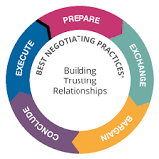
Building Trusting Partnerships
The Role of Colonization and Positionality in Global Health Systems

Slide 48



Cultural Humility in Global Health
Lifelong learning and critical self-reflection
Recognize and challenge power imbalances for respectful partnerships
Urge institutional accountability
Principles of Cultural Humility
Tervalon M, Murray-García J. Cultural humility versus cultural competence: a critical distinction in defining physician training outcomes in multicultural education. J Health Care Poor Underserved. 1998 May;9(2):117-25. doi: 10.1353/hpu.2010.0233. PMID: 10073197.
The Role of Colonization and Positionality in Global Health Systems
Notes:
One way to build trusting partnerships is by approaching your interaction with cultural humility. Well what exactly is cultural humility?
Cultural Humility is a term that was coined in the late 1990s by Dr's Melanie Tervalon and Jann Murrey-Garcia to move away from only providing cultural competence trainings to medical providers to a more comprehensive approach when interacting with individuals from a different culture than one is familiar with.
By culture, we mean any culture. (ie. Work culture, institutional culture, family culture, ethnic or racial culture, culture influenced by geographic location, etc.)
Approaching a person who has a different culture from our own. This happens every day. So in our work environment when trying to establish equitable partnerships, how can we incorporate cultural humility into that?
Well, cultural humility has three main pillars. They are:
Lifelong learning and critical self-reflection—means to constantly self-reflect on your actions, your words, did they land ok? Did something you say or how you approached something was considered offensive? How might you come back and repair that with your colleague? And remembering that it is not a one-off thing or event. No. You need to constantly self-reflect on how you interact with colleagues. How are you making your interactions in a way that nurtures equitable partnerships?
Recognize and challenge power imbalances for respectful partnerships—We've spoken about power earlier in the training, this pillar highlights the importance of recognizing your power and any power imbalances that occur in your interactions or partnerships. Recognizing those and challenging those to create a more equal partnership.
Urge Institutional Accountability—and lastly, urging institutional accountability meaning being a loud voice for any opportunity for change and improving systems and not necessarily accepting the status quo because that's what's been done in the past. If you or your colleague see a way that this partnership could benefit from a system's change, bring it up the chain and let your supervisor know, and hold them accountable to create the necessary steps to help improve equitable partnerships.
*********************************************

Slide 49
What is cultural humility?
A continuous, lifelong process where the individual examines their own beliefs, cultural identities, biases, and values as well as the beliefs and cultures of others
“Relinquishing the role of expert to becoming the student of the patient with a conviction and explicit expression of the patient’s potential to be a capable and full partner” (Tervalon, 1998)
The Role of Colonization and Positionality in Global Health Systems
Notes:
We just reviewed the three main pillars but how is cultural humility defined?
Cultural humility is defined as a life-long process where the individual examines their own beliefs, cultural identities, biases and values as well as the beliefs and cultures of others to create an environment of respect and mutual understanding between each other regardless of our differences.
Humility suggests that you will never know everything about another person, you will never know their entire history, their background. This is particularly true about communities that are different from your own.
The second definition of cultural humility mentions the word patient, but we can replace that with colleague or community we're working with. This second definition entails relinquishing the role of expert to becoming the student with a conviction and explicit expression of their potential to be a capable and full partner. I find this concept particularly relevant as it invites you not to be an expert, but a student of the person you are talking to and secondly it also sees the other person as an equal, capable and autonomous. Sometimes in our role at home we are considered "experts" in what we do. However, humility is admitting we're never experts in a topic. We're lifelong learners.
*********************************************

Slide 50
Cultural Humility in Practice
Lifelong Learning | Challenge Power Imbalances | Institutional Accountability
Learn your own culture, background, socialization patterns Practice critical self-reflection when drafting new research proposals | Build a partnership with your colleague Shared decision-making Active listening – using motivational interviewing techniques Create a win-win situation | Support local research ecosystems Transparency in funding Realistic timelines for collaboration
The Role of Colonization and Positionality in Global Health Systems
Notes:
How does cultural humility look in practice?
Lifelong Learning
Learn your own culture, background, socialization patterns
Practice critical self-reflection when drafting new research proposals—ask yourself, am I approaching this proposal with a win-win situation for all my partners?
Challenging Power Imbalances
Build a partnership with your colleague
Practice shared decision-making
Active listening – using motivational interviewing techniques
Create a win-win situation
Institutional Accountability
Support local research ecosystems
Transparency in funding
Realistic timelines for collaboration—true collaboration takes time.
*********************************************

Slide 51
Critical Self-Awareness
  Do I offer all counterparts the same information and recommendations? If so, or not, what informs this?
  What assumptions do I make about global counterparts based on our conversation and information they give me or their appearance?
  What are my personal and cultural values or beliefs and how do these influence my approach to this work?
  In what ways have fear, lack of knowledge, and systemic oppression influenced my own attitudes and actions?
  What steps can I take to minimize the effects of this personal bias?
  How can I use self-awareness to appreciate the multicultural and multigenerational identities of colleagues?
The Role of Colonization and Positionality in Global Health Systems
Notes:
Some questions to help you get started with critical self-awareness. You may ask yourself the following.
Do I offer all counterparts the same information and recommendations? If so, or not, what informs this?
What assumptions do I make about global counterparts based on our conversation and information they give me or their appearance?
What are my personal and cultural values or beliefs and how do these influence my approach to this work?
In what ways have fear, lack of knowledge, and systemic oppression influenced my own attitudes and actions?
What steps can I take to minimize the effects of this personal bias?
How can I use self-awareness to appreciate the multicultural and multigenerational identities of colleagues?
*********************************************

Slide 52
Small Group Activity #2
Breakout Session
(20 minutes)
Authorship Discussion with Cultural Humility
Objectives:
Reflect on the case presented and utilize resources and cultural humility skills to navigate the project negotiation.
Discuss the best strategies for creating a win-win partnership.
Report back: Select someone from your group to report back
The Role of Colonization and Positionality in Global Health Systems
Notes:
Let's jump into our next activity. We will have 20 minutes for a discussion around applying the principles of cultural humility during a proposed negotiation.
*************************************

Slide 53
Background Story
The world-renowned “Bates Foundation” funded an $8 Million Dollar clinical trial of a new drug innovation for pre-exposure prophylaxis drug for the prevention of HIV transmission and contraceptive product (PrECP). The study is supported by a collaboration between US and East-African health science institutions. The US-Principal Investigator (US-PI) was selected because they have received global recognition for similar research in other countries; however, they have never worked in Africa. The East African-Principal Investigator (EA-PI) is a global lead in both HIV prevention and contraception research.
The study is on its 2nd year and publications of the clinical trial has the US based doctoral student as first author and US-PI as last/senior author; The publication failed to include EA-PI or the East African Doctoral Student either as a second author or second senior author.
Notes:
Let's review our imaginary project.
READ SLIDE
The key players are:
US-Principal Investigator (US-PI)
East African-Principal Investigator (EA-PI)
US Doctoral Student
East African Doctoral Student
Let's breakout into our small groups and our facilitators will provide you with more information.
***********************************************

Slide 54
Welcome to the main room
Please use the chat or microphone to tell us how we can help you.
If you need to return to your breakout room, please tell us the room number or facilitator name.

Slide 55
Breakout Activity Debrief
Please share with the larger group the key points from your small group discussion.
  Reflect on the case presented and utilize resources and cultural humility skills to navigate the project negotiation.
  Discuss the best strategies for creating a win-win partnership.
The Role of Colonization and Positionality in Global Health Systems
Notes:
Welcome back again! How was this activity? Who wants to go first and report back on something that was shared in your groups that stayed with you?
HOST: if no learner volunteers, ask facilitators to share back.
****************************************

Slide 56
Let Local
Priorities Lead

Slide 57
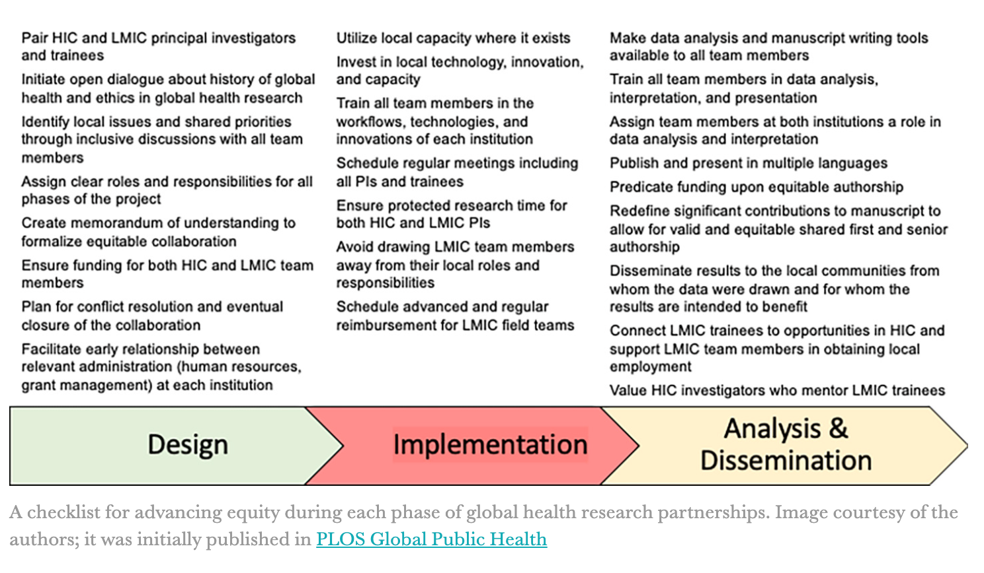
The Role of Colonization and Positionality in Global Health Systems
Notes:
https://www.statnews.com/2023/01/27/checklist-help-decolonize-global-health-research/
This figure might look familiar, it was included in one of the self-study materials on .
This is the Douala Equity Checklist which was created to help institutions in LMIC decide on local issues, solutions, and goals;
determine the terms of collaborations
decide how global health scholarship involving their institutions should take place;
and ultimately decide whether a proposed collaboration should occur at all,
This is also meant to help institutions in high-income countries assess project equity throughout the entire research process.
We recommend keeping this handy when you’re developing new partnerships.
********************************

Slide 58
Alternative Approaches to the Global Health Agenda
Challenge
Challenge neocolonial influences
Prioritize
Prioritize the needs of marginalized populations
Aim
Aim to address the root causes of global health inequalities
The Role of Colonization and Positionality in Global Health Systems
Notes:
Alternative approaches seek to challenge the neocolonial influences on the global health agenda and prioritize the needs of marginalized populations.
These approaches aim to address the root causes of global health inequalities and prioritize the needs of marginalized populations.
***********************************************

Slide 59
Decolonizing Global Health
Decolonization entails acknowledging colonial legacies of harm in order to support efforts to build more equal societies.
Decolonizing Global Health means critically examining the historical and ongoing power imbalances within the field and taking concrete steps to remedy them by prioritizing the voices and experiences of marginalized communities.
It entails action at different levels—individual and collective!
https://www.devex.com/news/sponsored/opinion-beyond-the-buzz-words-dei-and-decolonizing-global-health-104586
The Role of Colonization and Positionality in Global Health Systems
Notes:
Although this training is titled "The Role of Colonization and Positionality in Global Health Systems" it was an effort that began with discussions around developing a training on decolonizing global health. So we want to acknowledge the term and some definitions from the literature out there that we have settled on collectively.
Decolonization entails acknowledging colonial legacies of harm in order to support efforts to build more equal societies.
Decolonizing Global Health means critically examining the historical and ongoing power imbalances within the field and taking concrete steps to remedy them by prioritizing the voices and experiences of marginalized communities.
It entails action at different levels—individual and collective!
****************************************************

Slide 60
Anti-colonial Approach & Localizing
Anti-colonial | Localizing
Focused on addressing ways in which power imbalances and historical injustices shape global health Centering the voices and experiences of marginalized communities Addressing money / funding imbalances | Making global health more responsive to local contexts and communities
The Role of Colonization and Positionality in Global Health Systems
Notes:
Decolonizing Global Health implies that we have dismantled all colonial legacies which seems like a huge thing to accomplish and can feel overwhelming. Although that is our end goal, we will discuss having an anti-colonial approach to how we conduct partnerships.
Being anti-colonial in global health refers to the process of dismantling the artifacts of colonial power and racial oppression in the field of global health, and replacing them with perspectives, practices, and policies that prioritize the health and well-being of marginalized communities. This process involves recognizing and addressing the continued influence of colonialism, racism, and imperialism, which have led to the exploitation and subjugation of people and communities in the Global South.
Being anti-colonial in global health also means recognizing and valuing the knowledge, perspectives, and experiences of people and communities in the Global South, and centering their perspectives in the design, implementation, and evaluation of global health programs and policies. It also means addressing the structural inequalities that drive health disparities by working to promote health equity.
In short, an anti-colonial approach to global health means critically examining the historical and ongoing power imbalances within the field and taking concrete steps to remedy them by prioritizing the voices and experiences of marginalized communities.
Being anti-colonial in global health also means addressing money and funding imbalances.
Another word that we hear a lot in our work is Localizing.
Localizing global health refers to the process of making global health more responsive to the specific needs and priorities of local communities, by involving them in the design, implementation, and evaluation of global health programs and policies. This approach emphasizes the importance of understanding the unique cultural, social, economic, and political factors that shape health outcomes in different contexts.
SHOULD WE INCLUDE THE TEXT BELOW?
Decolonizing global health, on the other hand, is a more comprehensive approach that goes beyond just involving local communities to focus on the long-standing power imbalances within the field of global health. It involves recognizing and challenging the ways in which colonialism, racism, and imperialism continue to shape global health, and replacing those structures with perspectives, practices, and policies that prioritize the health and well-being of marginalized communities.
In short, localizing global health is focused on making global health more responsive to local contexts and communities, while decolonizing global health is focused on addressing the ways in which power imbalances and historical injustices shape global health and promote health equity by centering the voices and experiences of marginalized communities.

Slide 61
A New Vision for Global Health
Global Health Equity
Community-led Approaches
Health as a Human Right
South-South Cooperation
The Role of Colonization and Positionality in Global Health Systems
Notes:
A new vision for global health would look like this:
Global Health Equity
prioritizes health equity and social justice as central to the global health agenda
recognizes that health is influenced by broader social determinants such as poverty, education, and access to resources, and seeks to address these underlying factors.
Community-Led Approaches
emphasizes the importance of community-led solutions to global health challenges.
prioritizes the involvement of communities in decision-making processes and recognizes their expertise and knowledge
Health as a Human Right:
views health as a human right and advocates for policies that prioritize the right to health for all individuals.
challenges the commodification of health and prioritize the provision of universal access to health care.
South-South Cooperation:
promotes cooperation and collaboration between countries in the global South to address common health challenges.
challenges the power dynamics of traditional North-South partnerships and prioritize mutual learning and exchange.
Is there anything else you would add?
*********************************************

Slide 62
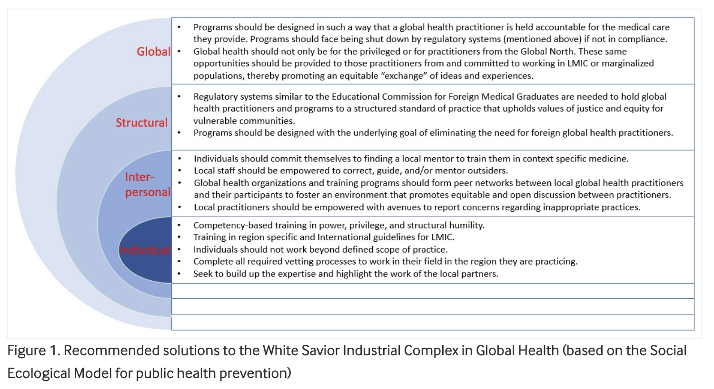
The Role of Colonization and Positionality in Global Health Systems
https://blogs.bmj.com/bmjgh/2020/03/11/the-white-savior-industrial-complex-in-global-health/
Notes:
The goal of Global Health is to promote health equity and social justice. The white savior industrial complex (WSIC) is embedded across different levels, and therefore, decolonization of global health practice should address the WSIC at all of those: 1) individual 2) interpersonal 3) structural, and 4) global (based on the social-ecological model for public health prevention)

Slide 63

Re-imagining Training
Recommendation: Programs should provide competency-based training in power, privilege and structural humility. All participants receive training in region-specific and international guidelines for LMICs.
Problems: Persistent narrative taught in the Global North that those in the Global South are unable to provide quality healthcare to their own people. Trainees or practitioners who participate in GH experiences are unprepared to work safely in these settings.
The Role of Colonization and Positionality in Global Health Systems
https://blogs.bmj.com/bmjgh/2020/03/11/the-white-savior-industrial-complex-in-global-health/

Slide 64
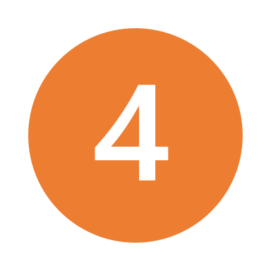
Re-imagining Program Design
Recommendation: Programs understand and work towards the understanding that the underlying goal of these programs is to eliminate the need for foreign GH practitioners.
Local practitioners should be empowered with avenues to report concerns regarding inappropriate practices
Programs should have a relationship with international sites and support local staff to correct, guide and mentor outsiders
Incorporate opportunities for reciprocity for practitioners from & committed to permanently working in LIC, LMIC or marginalized populations
The Role of Colonization and Positionality in Global Health Systems
https://blogs.bmj.com/bmjgh/2020/03/11/the-white-savior-industrial-complex-in-global-health/
Notes:
An example can be made out of UCSF's HEAL Initiative (Health, Equity, Action & Leadership)
MR: LMICs only? What about LICs

Slide 65

Re-imagining Regulation
Recommendations
Programs ensure that practitioners are held accountable for the care, services, and support they provide, or face being shut down by regulatory systems. Hold them to a standard of practice that uphold values of justice and equity for vulnerable communities.
Problems
Provider from the GN often works without appropriate licensure/supervision, contrary to the mechanisms in the GN
In the GS there may be no regulatory board overseeing these programs.
This can draw those who seek to “hone [new] skills” without fear of recompense and at its subtlest attract those with good intentions who, unprepared, cause harm.
The Role of Colonization and Positionality in Global Health Systems
https://blogs.bmj.com/bmjgh/2020/03/11/the-white-savior-industrial-complex-in-global-health/
Notes:
MR: I would be cautious that ‘often’ is accurate. In global health settings that I have worked, regulatory approval has been required… Perhaps ‘sometimes’

Slide 66

Re-imagining Individual Action
Practitioners should commit to finding local mentors for training in context-specific medicine.
They should not work beyond their defined scope of practice.
They should complete all required vetting processes to work in their field in the region they are practicing.
They should seek to build up the expertise and highlight the work and agency of the local partners.
The Role of Colonization and Positionality in Global Health Systems
https://blogs.bmj.com/bmjgh/2020/03/11/the-white-savior-industrial-complex-in-global-health/

Slide 67
“Global Health was birthed in supremacy, but its mission is to reduce or eliminate inequities globally. To transcend its origins, global health must become actively anti-supremacist, and also anti-oppressionist and anti-racist. Equity and justice involve flipping every axis of supremacy on its head.”
  -Seye Abimbola and Madhukar Pai, ‘Will global health survive its decolonisation?’
Notes:
To wrap up I’d like to share another quote from the article "Will global health survive its decolonization?"
“Global Health was birthed in supremacy, but its mission is to reduce or eliminate inequities globally. To transcend its origins, global health must become actively anti-supremacist, and also anti-oppressionist and anti-racist. Equity and justice involve flipping every axis of supremacy on its head.”
****************************

Slide 68
Self-Reflection
Reflect on the implications of neocolonialism on global health and potential solutions to address the problem.
How does coloniality show up in my global health practice?
What can I do to address neocolonialism in global health?
The Role of Colonization and Positionality in Global Health Systems
Notes:
Qualtrics? To remind of answers for one step they will take to combat coloniality

Slide 69
It’s Our Responsibility
Educate yourself
Reflect on your own power and privilege (situational)
Amplify voices
Support community-led initiatives
Get involved in policy advocacy
Practice cultural humility
The Role of Colonization and Positionality in Global Health Systems
Notes:
Decolonizing global health means different things for each of us, depending on our work, roles, power and privilege. But here are a few things we can all do
:
Educate ourselves: Learn about the history and ongoing impacts of colonialism, racism, and imperialism on global health and health disparities. Read books, articles, and research studies written by scholars and practitioners from marginalized communities.
Reflect on our own privilege and biases and recognizing how they may shape our understanding and approach to global health.
Amplify the voices and perspectives of marginalized communities.
Support community-led initiatives: Look for ways to learn from and support community-led initiatives that are working to promote health equity.
Get involved in policy advocacy: Learn about and get involved in efforts to address structures that drive health disparities through policy.
Practice cultural humility: Make a conscious effort to be respectful, open-minded, and willing to learn from people and communities with different backgrounds, experiences, and perspectives.
Decolonizing global health is a long-term process that requires continual learning, reflection, and action.
***********************************

Slide 70
Training Next steps
Provide feedback on this training by completing the survey
Stay tunned for future trainings
The Role of Colonization and Positionality in Global Health Systems

Slide 71
A brighter future is possible---
- Olusoji “Soji” Adeyi, President, Resilient Health Systems
The Role of Colonization and Positionality in Global Health Systems

Slide 72
List of resources
Packard, R. M. (2016). A history of global health: interventions into the lives of other peoples. Baltimore, MD.
https://pubmed.ncbi.nlm.nih.gov/10073197/
Pre-work: This is the requested pre-work for learners to review prior to your session
Watch: https://www.youtube.com/watch?v=XA5ip6raULg&feature=youtu.be
Watch: https://www.youtube.com/watch?v=uHvm4tGCOQk
Read: Airhihenbuwa_Racism is global_URise Blog 2020
Read: De Maio and F_GH Perspectives_Book Chapter YYYY
Read: HedtGauthier_Academic promotions and equity_Lancet 2018
Read: Jumbam_Writing about GH_BMJGH 2020
Read: Kalinga_Rock and hard place_JACS 2019
Read: Mutapi F_Africa should set own agenda_Nature 2019
Toolkit: Intro to decoloniality and anti-racism in global health: Student Toolkit https://researchonline.lshtm.ac.uk/id/eprint/4664957/
Watch video: https://www.youtube.com/watch?v=ueoDL9JOQNY How the legacy of European colonialism is shaping Africa's future

